Slide 1
r/Reddit network analysis
Munteanu Bianca-Stefania
Murariu Alexandra
Circular Layout Visualization: circular layout, useful for spotting symmetries

Slide 2




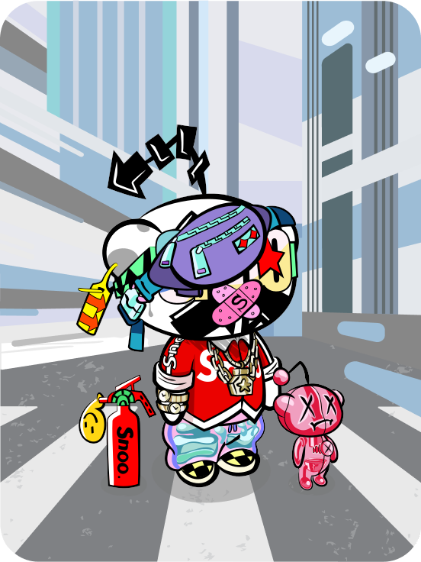

Search Reddit
Log In
Sign Up
Trending today
r/politics and more
r/SquaredCircle and more
r/news and more
Popular posts
Hot
Everywhere
New
Top
r/DnD
Posted by u/abc
17 hours ago
Join
1
r/mildlyinteresting
21.7k
[OC] Giveaway! Hand-carved solid wood Dice Box
OC
2
r/funny
3
r/space
4
r/worldnews
Notes:
Reddit is a popular social media platform and online community where users can post content, engage in discussions, and vote on posts. The platform is organized into individual communities known as subreddits, each dedicated to a specific topic or interest. Users can create threads by submitting posts, which can include text, links, images, or videos and other users can then reply to these posts, creating a thread of comments

Slide 3

r/Data extraction
PRAW - “Python Reddit API Wrapper”, is a python package that allows for simple access to reddit's API
Data extracted from this months's top 20 posts from TopMindsOfReddit subreddit
N = 806 nodes as reddit users
L = 2082 edges representing replies(comments) between users
The edges have also a sentiment score (computed from user comment)

Slide 4






r/Data exploration
Notes:
On this slide we can see some titles of this month's top posts:
Top minds all join together to complain about how they're being censored
Top mind's taxes are going towards public education
Top minds have politics all figured out

Slide 5

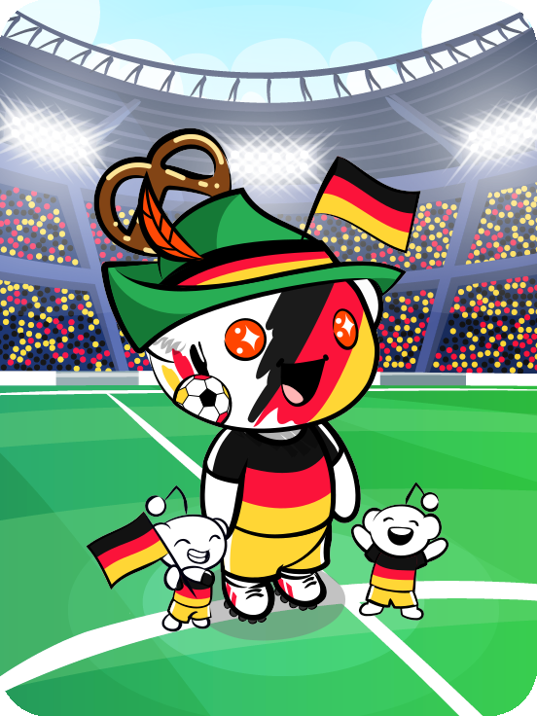
U/Sentiment Analysis
DistilBERT model
Assigned negativity score for each comment
Computed the mean negativity score for each user by averaging the negativity scores of all comments made by the user
Positive Comment Example:
Comment: This is one of the funniest posts I’ve ever read.
Sentiment Analysis Label: "POSITIVE"
Negativity Score: 0.001
Justin
u/justin001 • 4y
Style Avatar
Negative Comment Example:
Comment: I hate you, don't want to interact with you and want you excluded from society
Sentiment Analysis Label: NEGATIVE
Negativity Score: 0.99
Karma
Cake day
50,496
May 19, 2019
Followers
111>
justin001
justin001
New Post

Slide 6
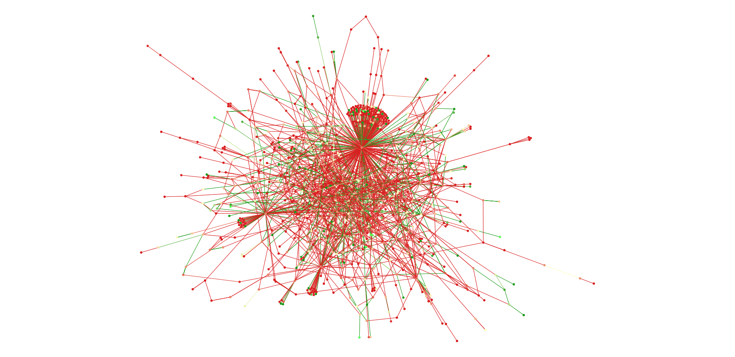
r/Visualizations
Force Atlas Layout
Notes:
Gephy
Nodes and edges are colored according to their negativity score, where green means positive and red means negative

Slide 7
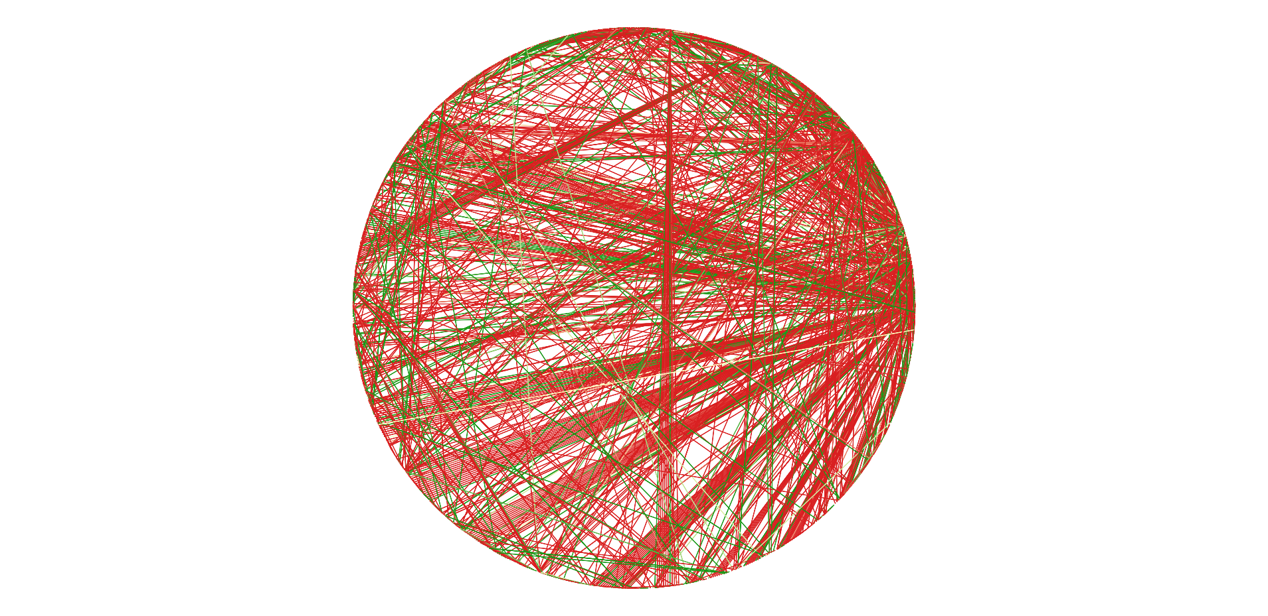
r/Visualizations
Circular Layout

Slide 8
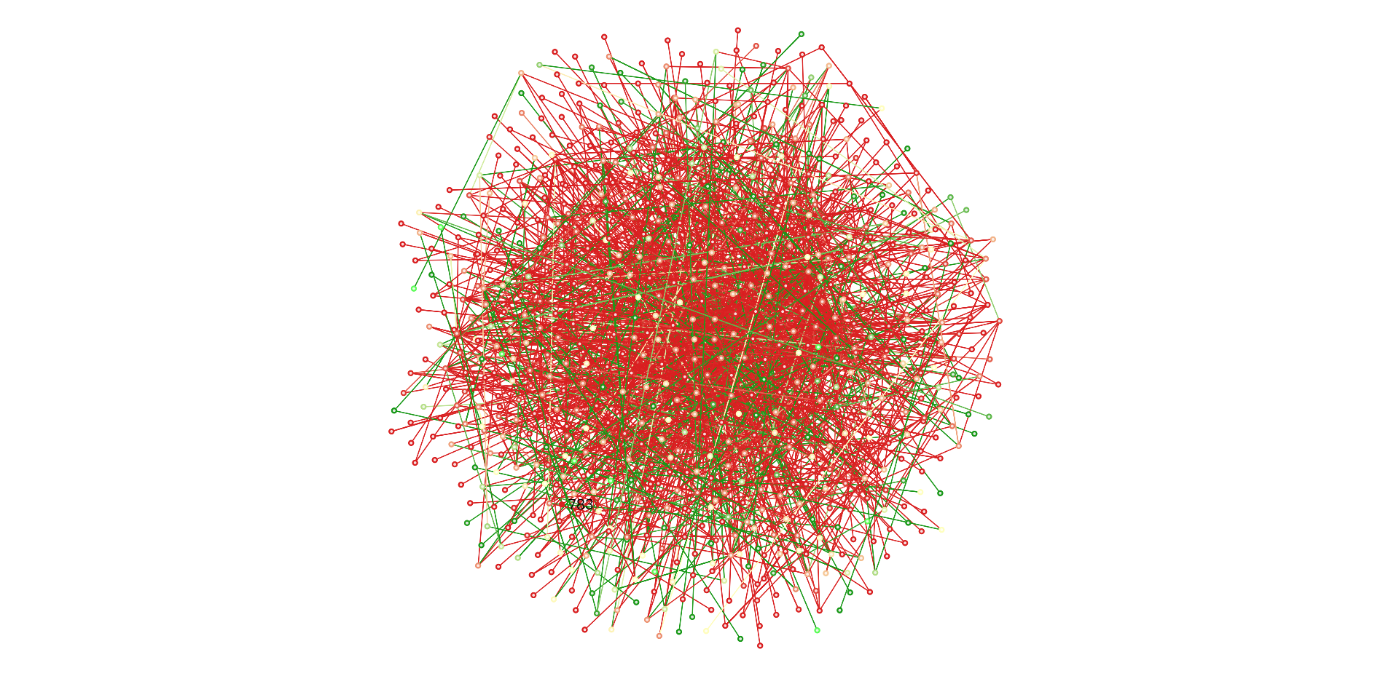
r/Visualizations
Random Layout

Slide 9
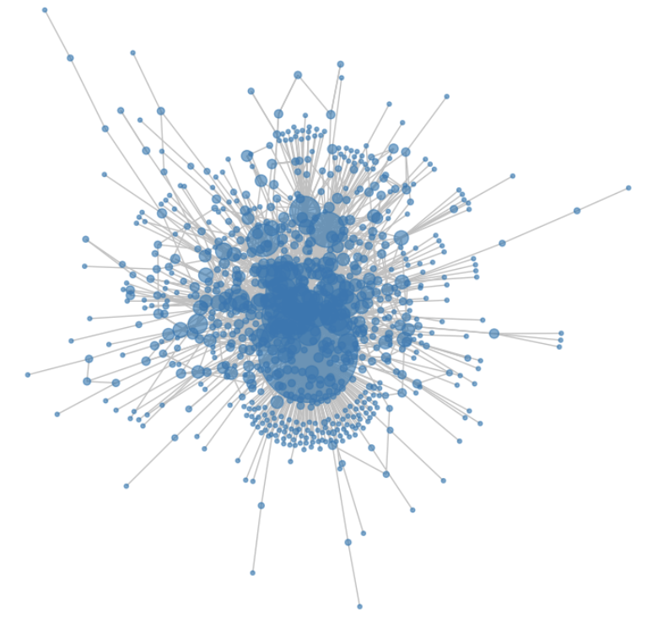
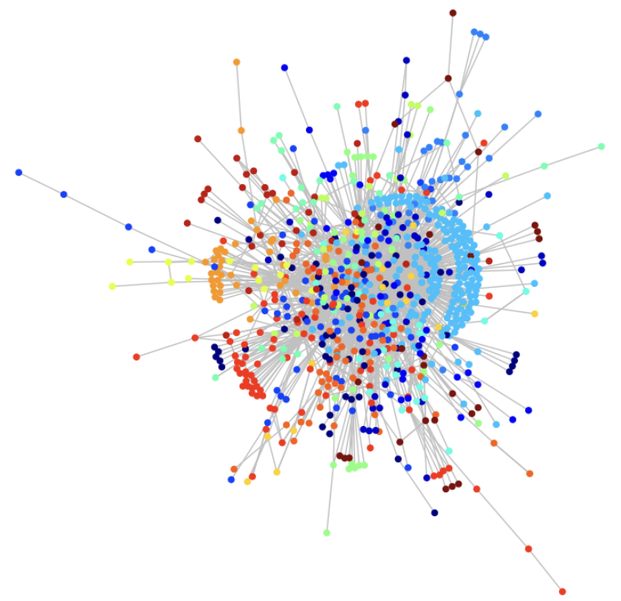
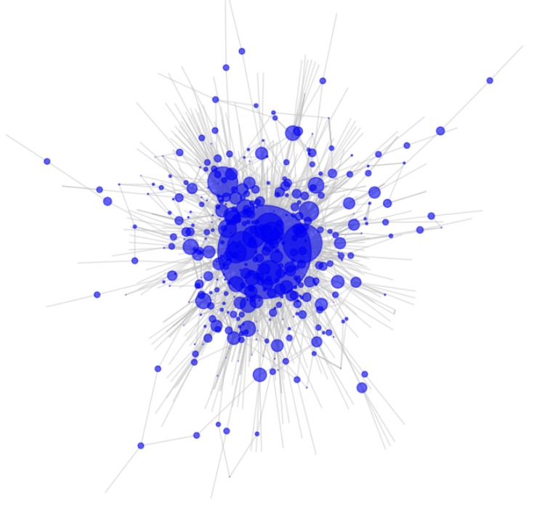
r/Visualizations
Node Degree Size
Community Detection
Betweenness Centrality

Slide 10
Average degree: 5.166
Min degree: 1
Max degree: 580
Diameter: 10
r/Network properties
The network is connected, so it has only 1 connected component
Size of the largest connected component: 806
Average shortest path length: 3.391
Average clustering coefficient: 0.118
Edge density: 0.006

Slide 11
Average degree: 5.166
Min degree: 1
Max degree: 580
r/Network properties (2)
Avg degree is closer to the min degree, while max degree is much higher than min/mean (skewed degree distribution) => first indication the network could be a power-low (or some heavy-tailed distribution), but this is not yet fully confirmed.

Slide 12
Average clustering coefficient: 0.118
Edge density: 0.006
r/Network properties (3)
Avg clustering coeff >> edge density, so there is a moderate level of clustering, but the network is sparse overall (because of the low edge density). This is typical for a real-world network.

Slide 13
R/Barabasi-Albert and Erdos-Renyi
BA scale-free network
Number of nodes: 806
Number of links: 1608
Average degree: 3.99
Min degree= 2
Max degree= 95
Size of the largest connected component: 806
Diameter: 7
Average shortest path length: 4
Average clustering coefficient: 0.034
Edge density: 0.004
ER random network
Number of nodes: 806 Number of links: 2141
Average degree: 5.312
Min degree= 0
Max degree= 14
Number of connected components: 5
Size of the largest component: 802
Diameter of the largest component: 8
Average shortest path length of the largest component: 4.188
Average clustering coefficient: 0.006
Edge density: 0.006

Slide 14
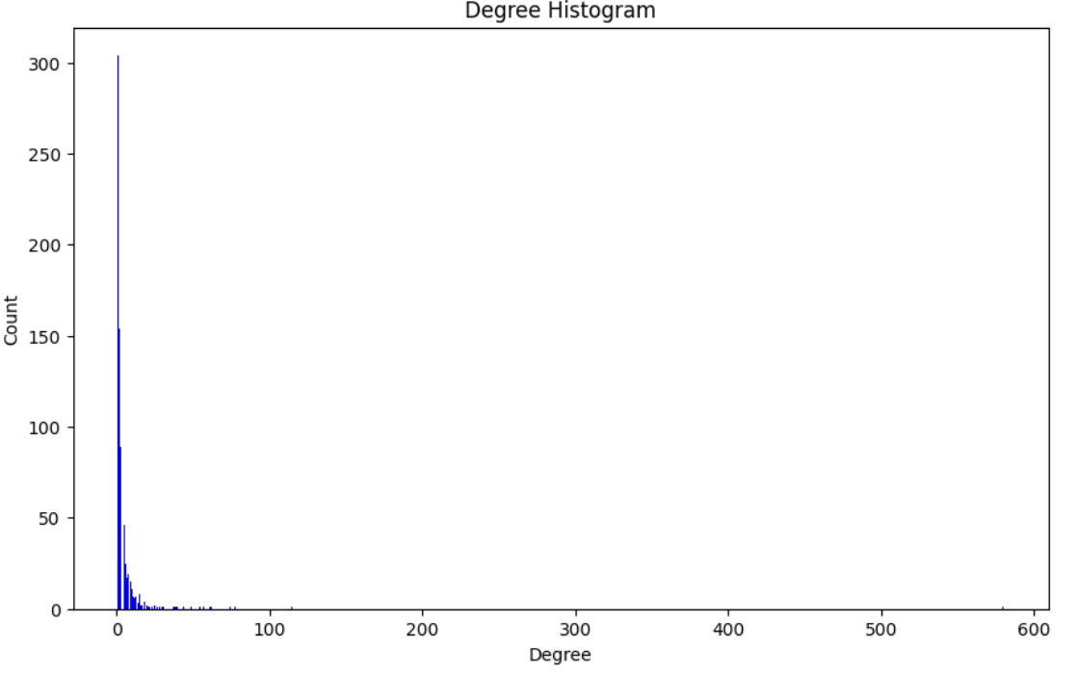
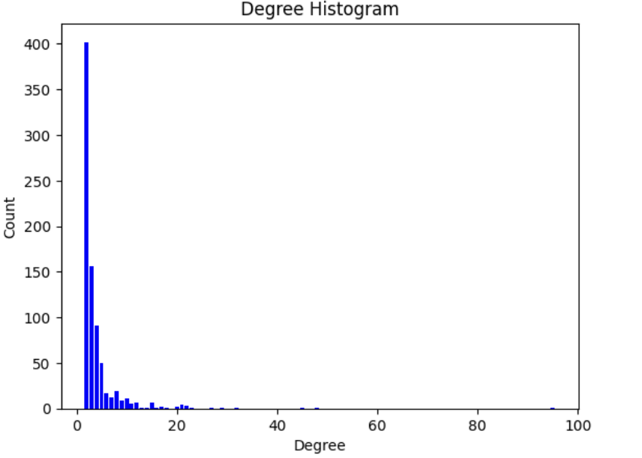
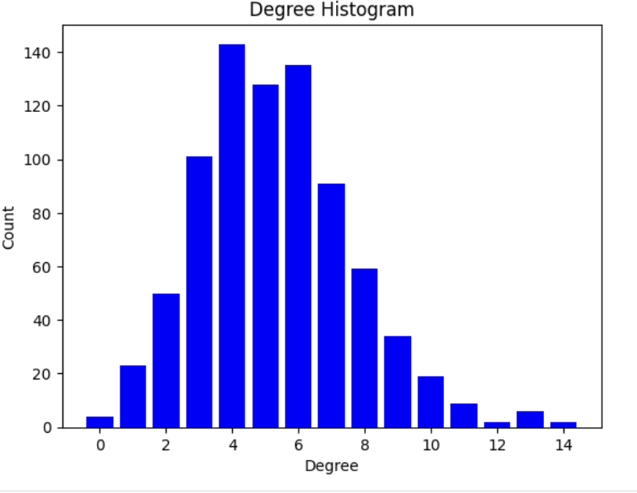
R/Plots – Degree Distribution Plot
Real
majority of nodes have a low degree
there is a node with an extremely high degree (580), which acts like a hub
distribution may suggest a scale-free property
Barabasi-Albert
majority of nodes have a low degree
there are a few nodes with a very high degree, which act as highly connected hubs
distribution is a clear indicative of a scale-free network, which is characterized by a power-law degree distribution
Erdos-Renyi
distribution may suggest binomial

Slide 15
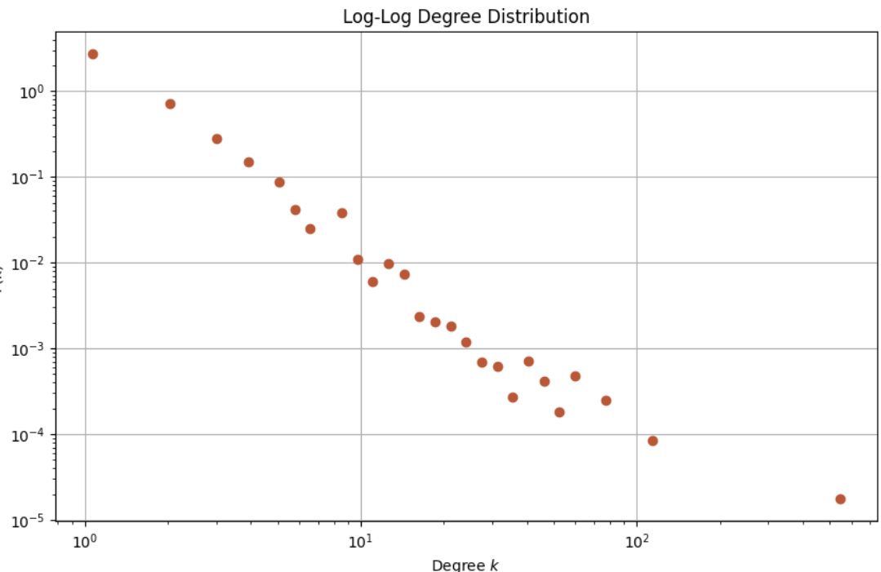
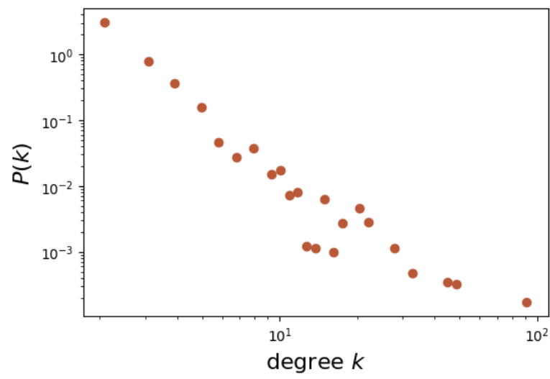
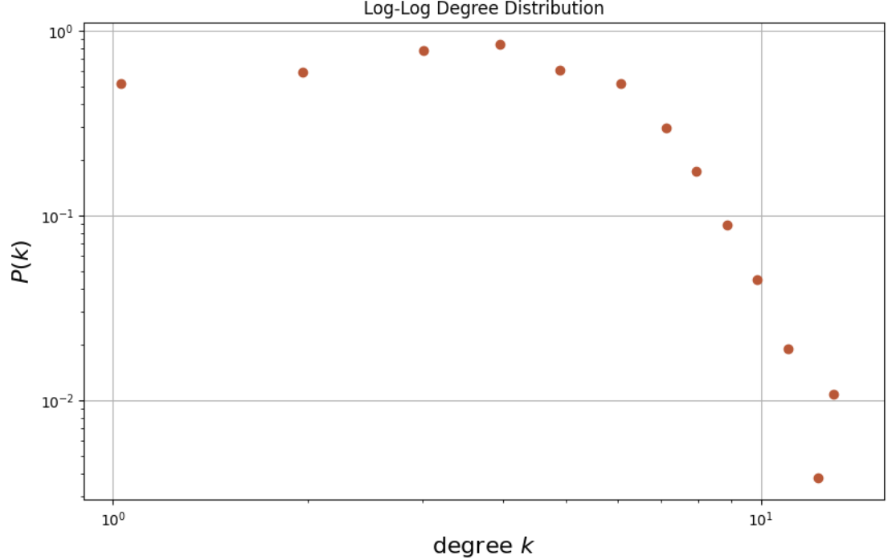
R/Plots – Log Log Plot
Real
from earlier we know that the avg degree is closer to the min degree
the degree distribution follows a straight line, characteristic of scale-free network
Barabasi-Albert
from earlier we know that the avg degree is closer to the min degree
shows a linear trend in the middle of log-log scale => characteristic of power-law behavior
however, some deviation from a straight line can be observed at the end
Erdos-Renyi
from earlier we know that the avg degree is about in the middle
it appears to have a concave downward shape. The tail follows almost a straight line, an indication of a power-law distribution, but the initial slope is completely different (we can observe the threshold phenomena).

Slide 16
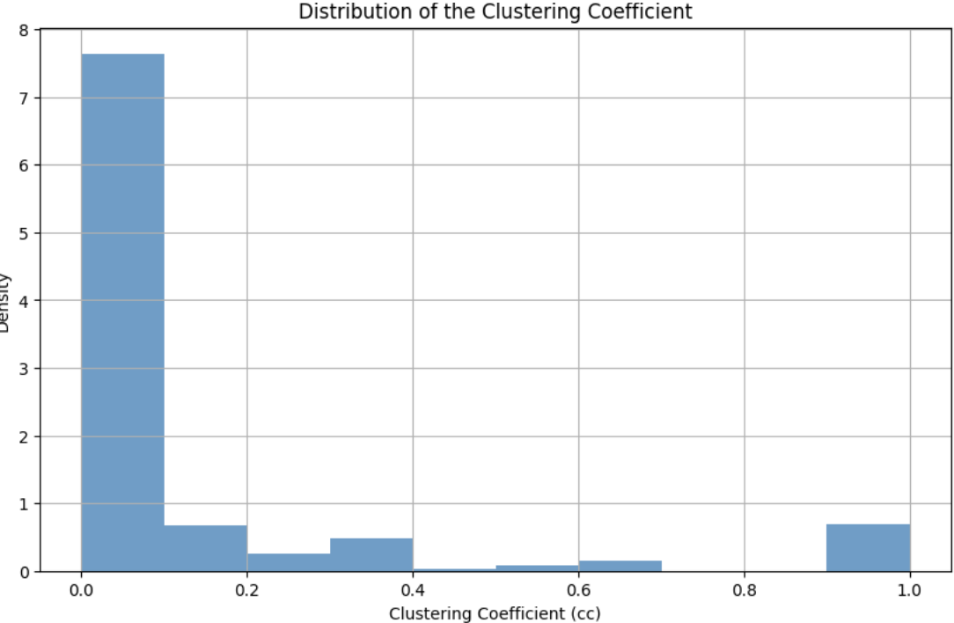
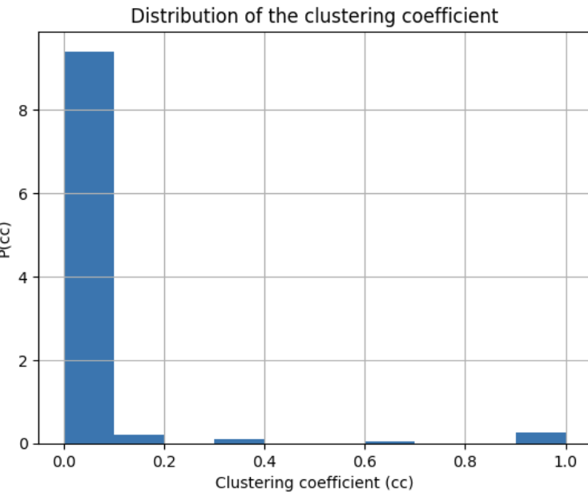
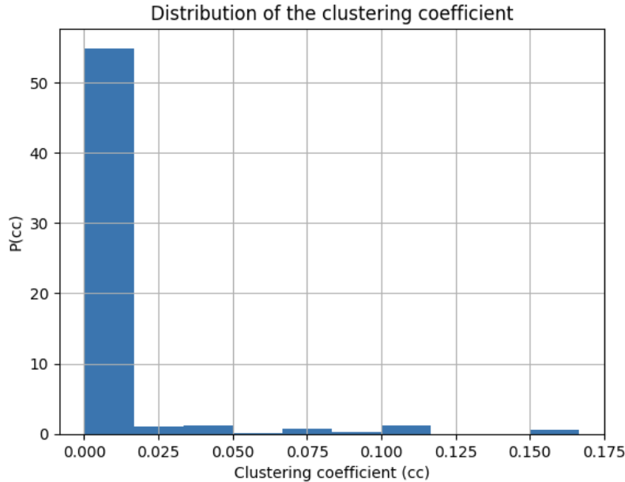
R/Plots – Clustering Coeff Plot
Real
low clustering for most nodes, indicating that many nodes are part of sparse local neighborhoods
presence of highly clustered nodes with high clustering coefficients (close to 1)
Barabasi-Albert
in scale-free networks, many nodes tend to have few connections, and these connections are less likely to form closed triangles, resulting in lower clustering coefficients for those nodes
the few highly connected nodes (hubs) might be part of clusters
Erdos-Renyi
the distribution is quite skewed, with a large number of nodes having a low clusering coefficient

Slide 17
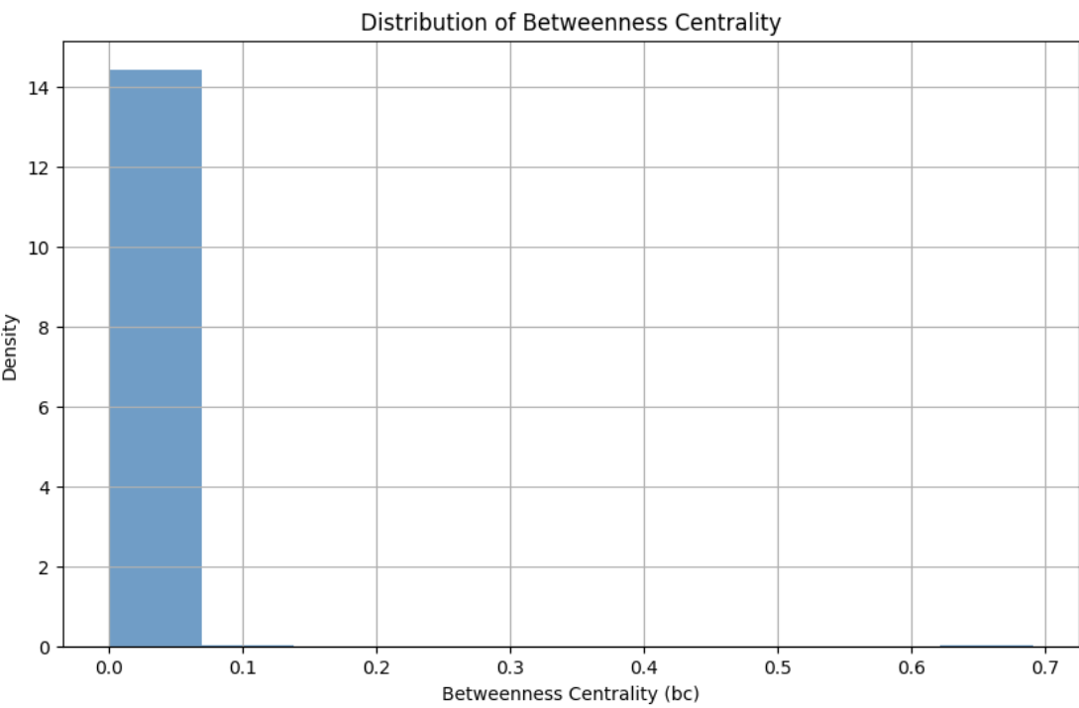
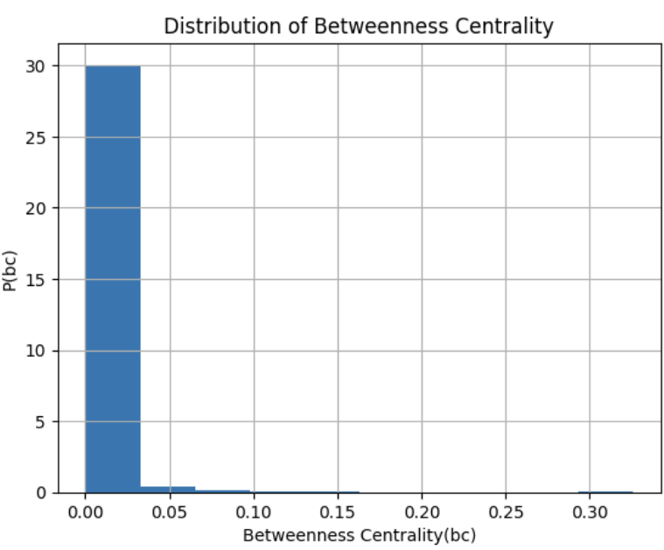
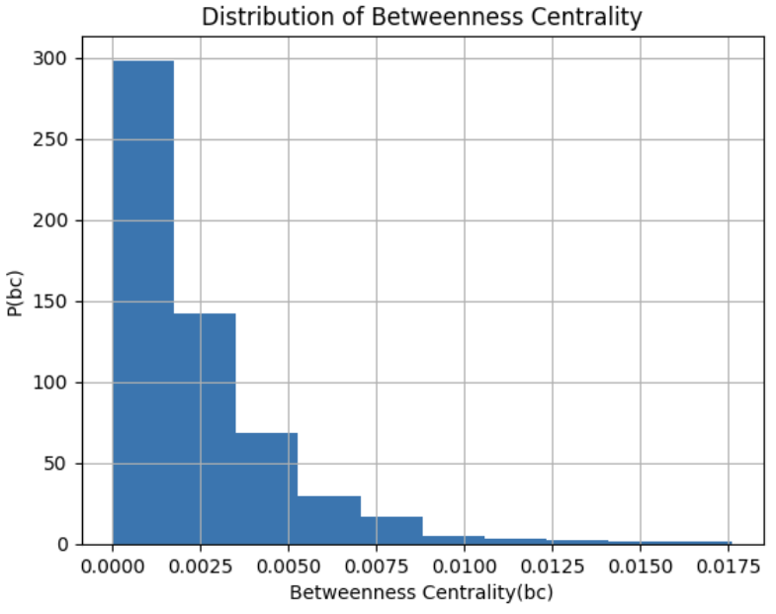
R/Plots – Betweenness Centrality Plot
Real
distribution is highly skewed, with most nodes having a very low betweenness centrality
Barabasi-Albert
distribution is heavily right-skewed, with a large number of nodes having a low betweenness centrality value
most nodes are not often on the shortest paths between other nodes, with only a few nodes having higher betweenness centrality
Erdos-Renyi
distribution is quite skewed, with a large number of nodes having a low betweenness centrality value, which is typical for many real-world networks. The tail is long, extending towards the higher values.
moste nodes have a low betweenness centrality, which is expected from a random, non-structured network.

Slide 18


U/The most important nodes
Node with the highest degree: 1 (Degree: 580)
Node with the highest clustering coefficient: 76 (Clustering Coefficient: 1.0)
Node with the highest degree centrality: 1 (Degree Centrality: 0.72)
Node with the highest betweenness centrality: 1 (Betweenness Centrality: 0.69)
Node with the highest closeness centrality: 1 (Closeness Centrality: 0.54)
Node with the highest eigenvector centrality: 1 (Eigenvector Centrality: 0.64)
Mean negativity scores:​
User 1 (username: PorridgeCranium2): 0.78​
User 76 (username BigBossPoodle): 0.99

Slide 19




r/Conclusions
Is the Network Scale-Free or Random?
The degree distribution, clustering coefficient, and centrality measures suggest that the real network has scale-free properties, similar to the Barabasi-Albert model.
Centrality of Negativity
Users with higher centrality measures tend to have higher negativity scores, indicating a pattern where negative users become central to the network.
Echo Chambers & Sentiment
Potential echo chambers exist where users with similar sentiments are densely interconnected.
Sentimental Pathways
The spread of sentiment, particularly negative sentiment, is concentrated around a few central users, influencing the overall sentiment of the network.

